Slide 1
Machine Learning DASC 522
Neural Network Foundations & Processes
Dr. Torrey Wagner

Slide 2
Overview
Big Picture
Background & Structure
Perceptrons
Perceptron Learning
Artificial Neural Networks (ANN or NN)
NN Learning
Optimization

Slide 3
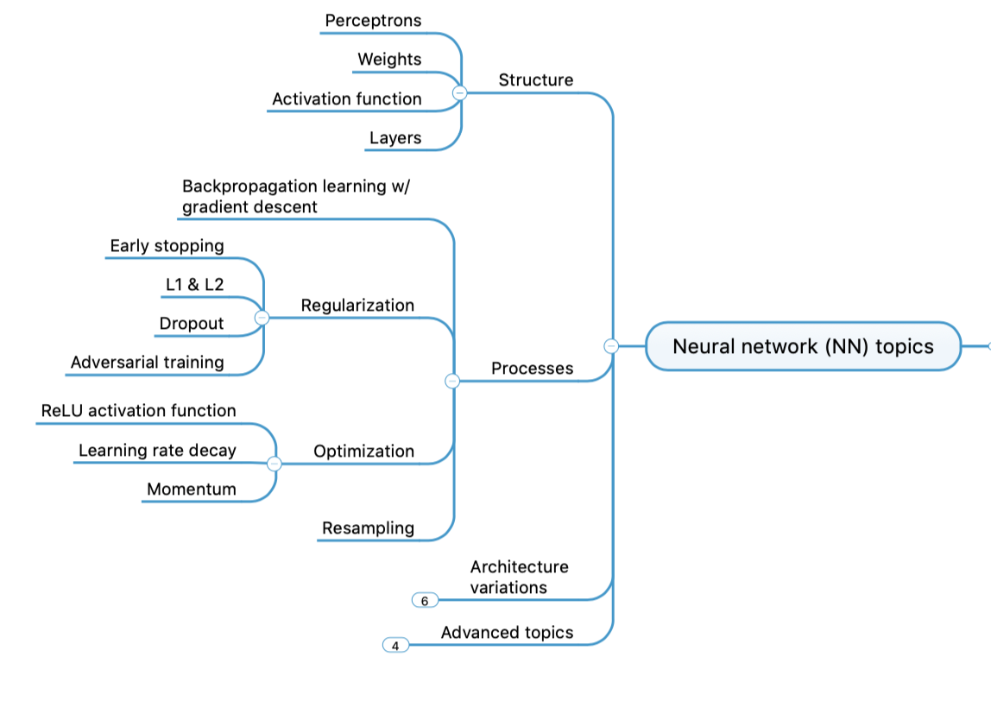
Concept Map - NN

Slide 4
Perceptrons
Perceptrons
ANNs
CNNs
RNNs

Slide 5
Artificial Neuron (Perceptron)
x₁
W₁
Neuron
INPUTS
W₂
Σ
f(n)
Outputs
W
Activation
Function
W
W=Weight
A Brief Overview on Neural Networks - Smart Engineering smarteng.mst.edu › smarteng › documents › EE401_new

Slide 6
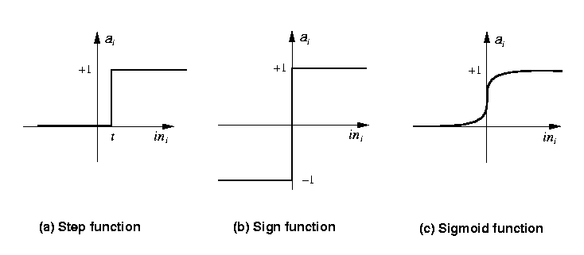
Activation Functions
Step_{t}(x) = 1 if x >= t, else 0
Sign(x) = +1 if x >= 0, else –1
Sigmoid(x) = 1/(1+e^{-x})
Rectified Linear Unit (ReLU)
www.cs.nott.ac.uk › ~pszgxk › aim › ppt › neuralnetw...

Slide 7
The Simple Perceptron – Inverter
input x1 | output
0 | 1
1 | 0
output
w₀= 0.5
1
w₁= −1
x₁
Slide from Dr. Brett Borghetti, AFIT/ENG CSCE 823 Advanced Machine Learning, 2019SU

Slide 8
The Simple Perceptron – Bool AND
input x1 | input x2 | output
0 | 0 | 0
0 | 1 | 0
1 | 0 | 0
1 | 1 | 1
output
w₀= −1.5
1
w₁=1
w₂=1
x₁
x₂
Slide from Dr. Brett Borghetti, AFIT/ENG CSCE 823 Advanced Machine Learning, 2019SU

Slide 9
The Simple Perceptron – Bool OR
input x1 | input x2 | output
0 | 0 | 0
0 | 1 | 1
1 | 0 | 1
1 | 1 | 1
output
w₀= −0.5
1
w₁=1
w₂=1
x₁
x₂
Slide from Dr. Brett Borghetti, AFIT/ENG CSCE 823 Advanced Machine Learning, 2019SU

Slide 10
The Simple Perceptron – Bool XOR?
input x1 | input x2 | output
0 | 0 | 0
0 | 1 | 1
1 | 0 | 1
1 | 1 | 0
output
w₀= ?
1
x₁
x₂
Slide from Dr. Brett Borghetti, AFIT/ENG CSCE 823 Advanced Machine Learning, 2019SU

Slide 11
The Simple Perceptron – Decision Surface
x₂
x₂
+
+
+
-
+
+
-
-
-
x₁
x₁
+
-
+
-
-
+
-
This is the XOR problem…
Perceptron is able to represent some useful functions (x₁,x₂) and choose weights w₀=-1.5, w₁=1, w₂=1
But functions that are not linearly separable (e.g. XOR) are not representable.
Slide from Dr. Brett Borghetti, AFIT/ENG CSCE 823 Advanced Machine Learning, 2019SU
Notes:
Et of all hyperplanes in n-dimensional space

Slide 12
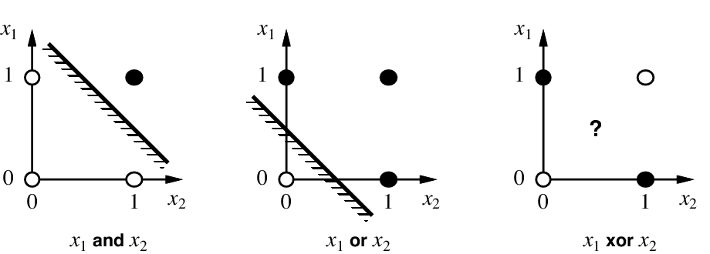
Linear separability
http://slazebni.cs.illinois.edu/fall17/

Slide 13
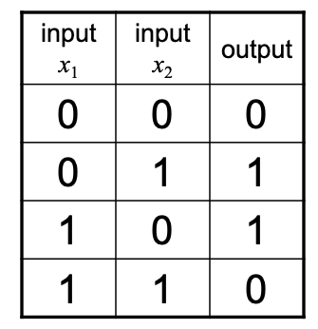
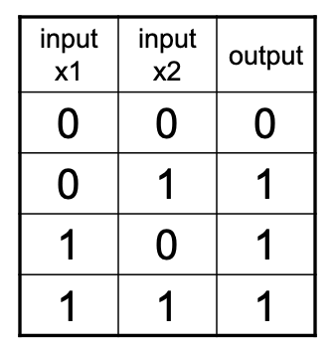
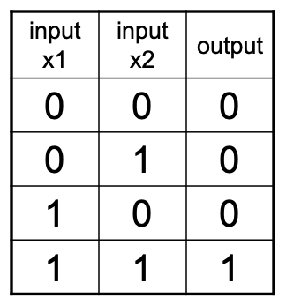
Boolean XOR using Simple Perceptron(s)
Result = XOR
What did we do here?
Added a layer
Allows us to do something more complicated
Built a non-linear discriminator
y
−0.5
1
−1
OR
AND
−0.5
h₁
h₂
−1.5
1
1
1
1
x₁
x₂
Slide from Dr. Brett Borghetti, AFIT/ENG CSCE 823 Advanced Machine Learning, 2019SU
Notes:
Network of multiple perceptrons can learn any boolean function

Slide 14
Overview
Big Picture
Background & Structure
Perceptrons
Perceptron Learning
Artificial Neural Networks (ANN or NN)
NN Learning
Optimization

Slide 15
Perceptron Learning
Perceptrons
ANNs
CNNs
RNNs

Slide 16
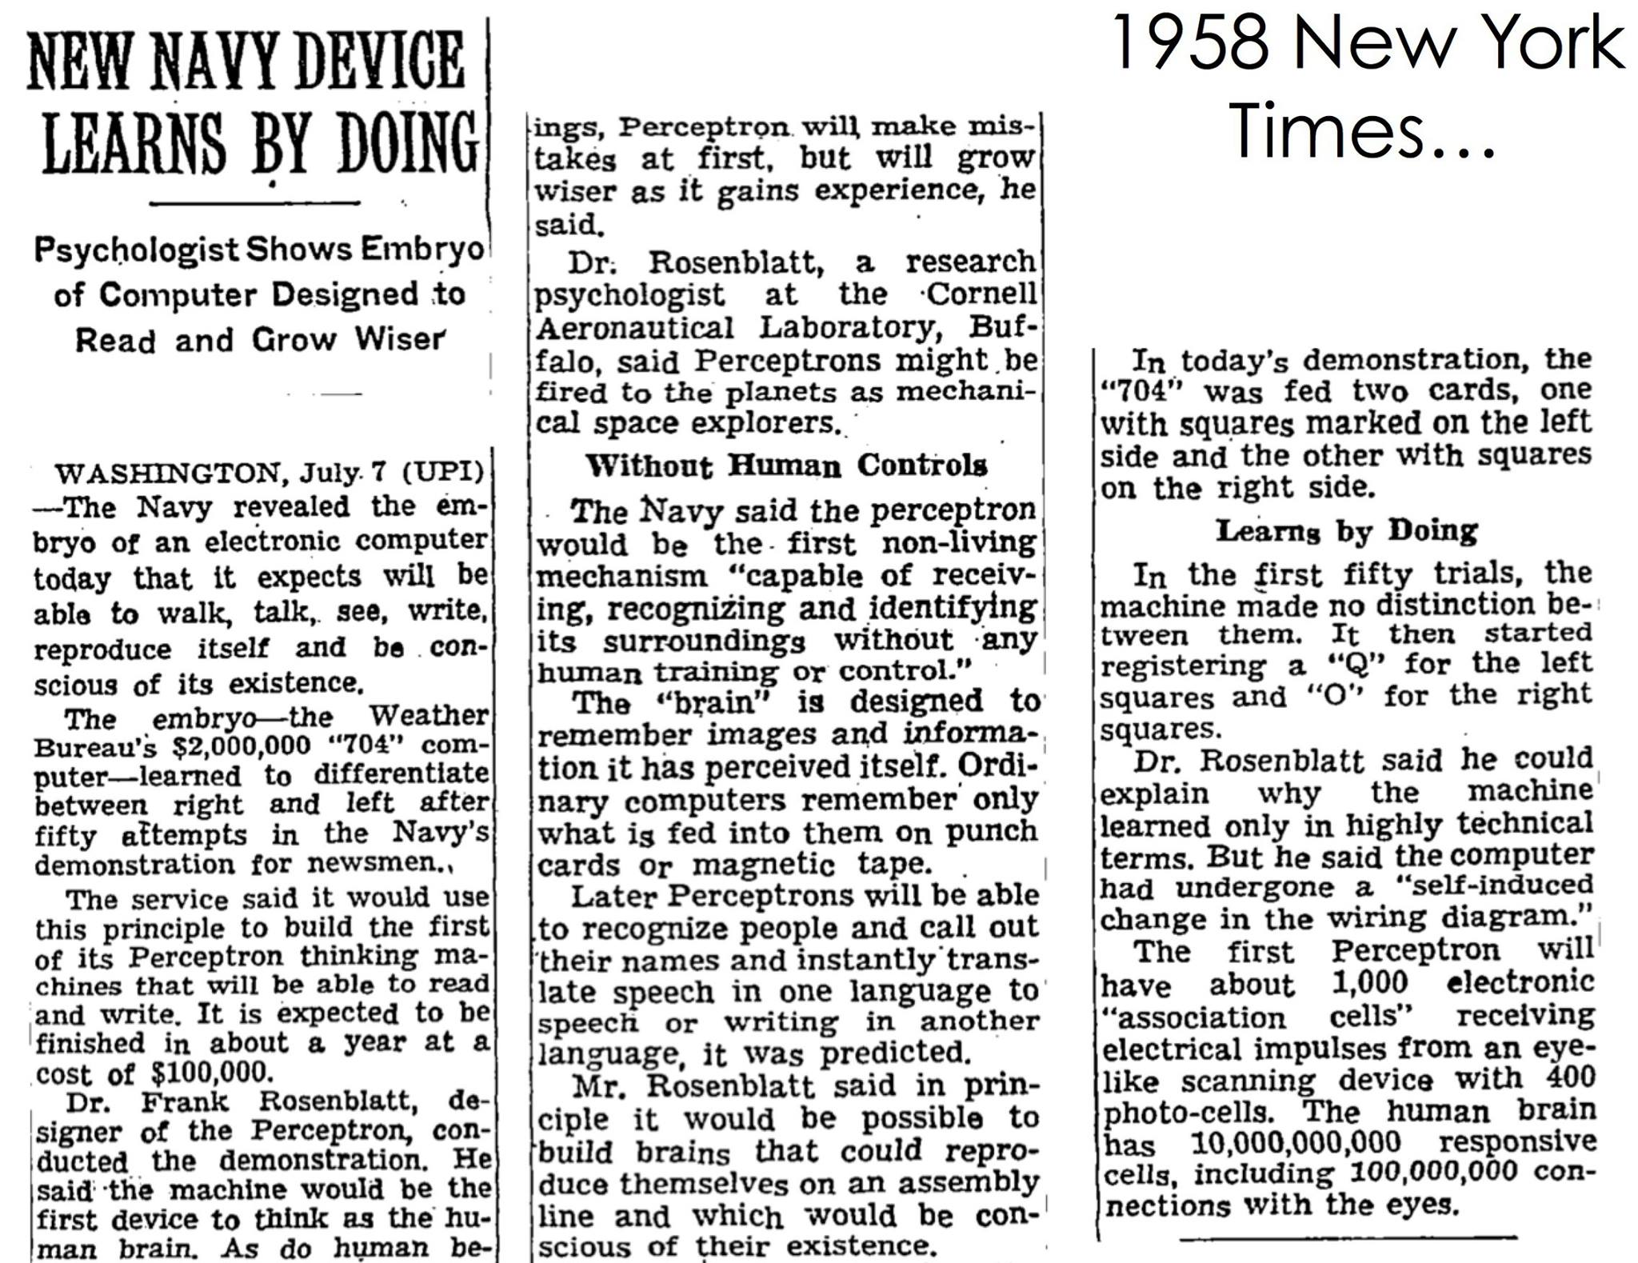
http://slazebni.cs.illinois.edu/fall17/

Slide 17
Revisit: Simple Perceptron without activation
Consider the simple linear perceptron
1:1 linear activation (activation is the value of “NET”)
Output is a continuous valued output
x₀=1
w₁
x₁
w₀
w₂
x₂
Σ
y
.
.
.
w_{n}
D is desired target
y is the prediction
x_{n}
y = w^{T}x = w₀ + w₁x₁ + … + w_{n}x_{n} = “NET”
Slide from Dr. Brett Borghetti, AFIT/ENG CSCE 823 Advanced Machine Learning, 2019SU

Slide 18
Revisit: Simple Perceptron without activation
Goal is to minimize the error
One of the most common error measures?
Squared Error (SE) or Mean Squared Error (MSE)
Define the error for one sample as
D is desired target
y is the prediction
Slide from Dr. Brett Borghetti, AFIT/ENG CSCE 823 Advanced Machine Learning, 2019SU

Slide 19
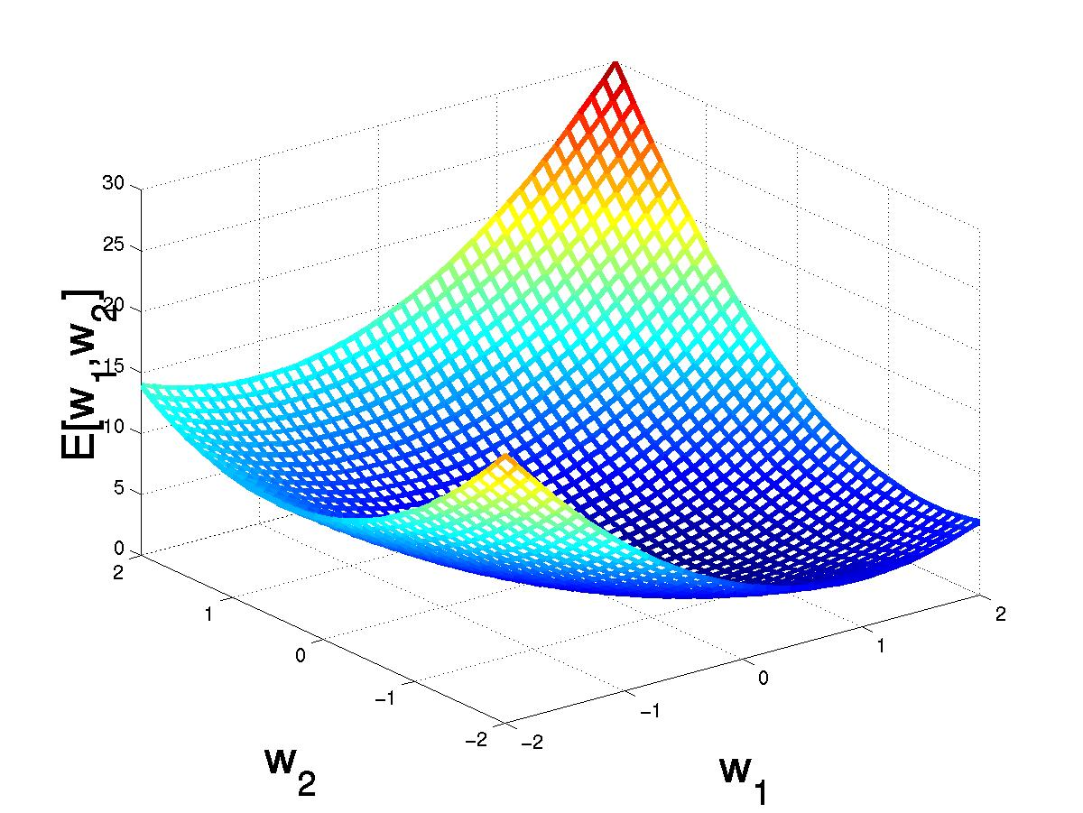
Gradient Descent in Weight Space
(w₁,w₂)
(w₁+Δw₁,w₂ +Δw₂)
Slide from Dr. Brett Borghetti, AFIT/ENG CSCE 823 Advanced Machine Learning, 2019SU
Notes:
Error surface for E(LMS) is always a parabolic with one global minimum FOR SINGLE LINEAR UNIT!

Slide 20
Ways to Assist Gradient Descent
Decayed learning rate
When our learning rate is too large, we don’t converge
When it is too small, gradient descent is too slow
One option is to start with a larger learning rate and make it slower via decay
Different Activation Functions
Logistic function (aka sigmoid): (0,1)
Tanh: (-1,1)
Slide from Dr. Brett Borghetti, AFIT/ENG CSCE 823 Advanced Machine Learning, 2019SU

Slide 21
Comparing Perceptron & GD Rules
Success definition: converge to the minimum squared error
Perceptron learning rule guaranteed to succeed if
Classes are linearly separable
Sufficiently small learning rate α(t)
Gradient descent guaranteed to succeed if
Sufficiently small learning rate α(t)
Converges even when training data contains noise
Converges even when training data are not linearly separable
Slide from Dr. Brett Borghetti, AFIT/ENG CSCE 823 Advanced Machine Learning, 2019SU

Slide 22
Perceptron Summary
Components
Weights
Summation
Activation Function
Activation Functions
Linear, threshold, Logistic, tanh()
Learning Rules
Perceptron learning
Gradient Descent
Slide from Dr. Brett Borghetti, AFIT/ENG CSCE 823 Advanced Machine Learning, 2019SU

